Slide 2
Gas chromatography

Slide 4
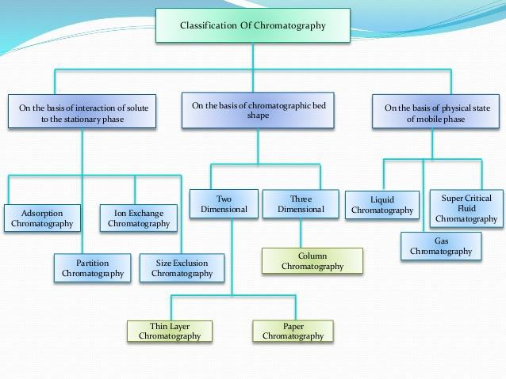

Slide 5
Gas Chromatography

Slide 6
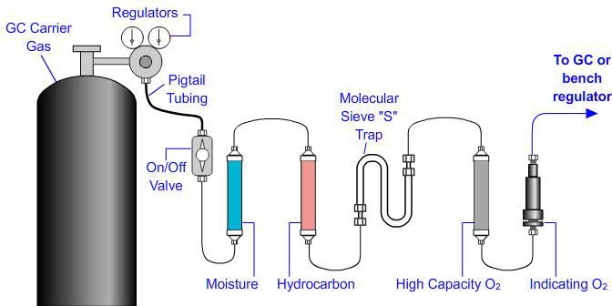
Carrier Gas-Supply
.

Slide 9
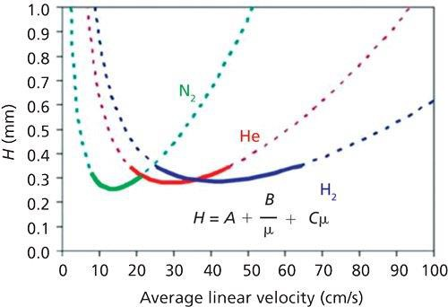

Slide 10
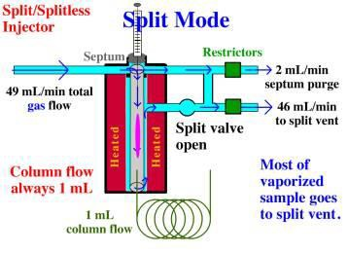
Sample Injection System

Slide 11
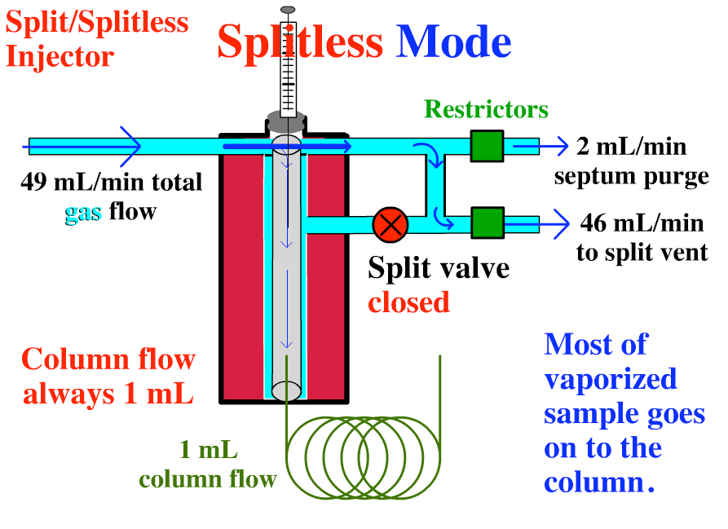
Sample Injection System

Slide 12
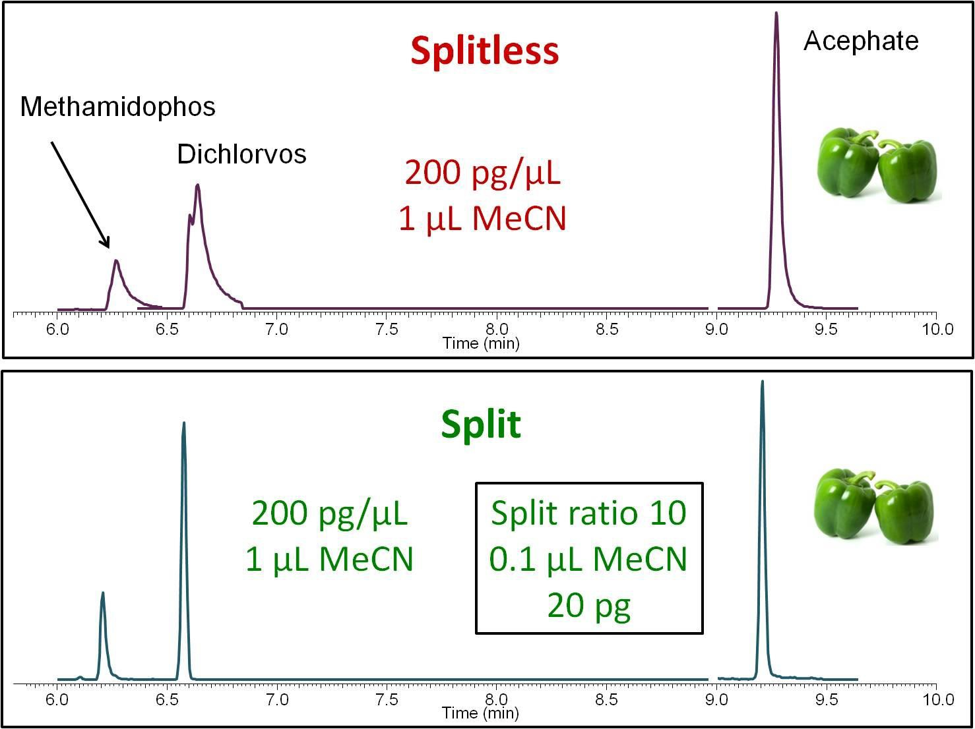

Slide 13
Column Configurations
Two general types of columns are encountered in gas chromatography, packed and open tubular, or capillary.
Chromatographic columns vary in length from less than 5 m to 120 m or more. They are constructed of stainless steel, glass, fused silica, or Teflon.

Slide 14
Types of Open Tubular Column
Solid support coated
with liquid phase
Porous
Adsorbent
Liquid phase
Wall-coated Open Tubular Support-coated Open Tubular
Porous Layer Open Tubular (PLOT)
(WCOT)
(SCOT)
FSOT: Fused-silica open tubular column
17

Slide 15
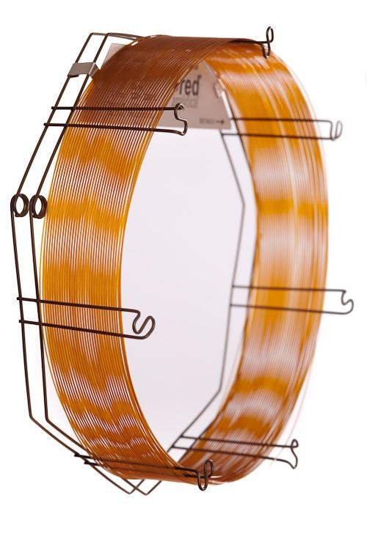
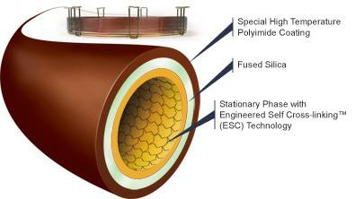
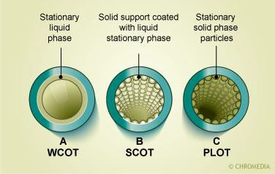
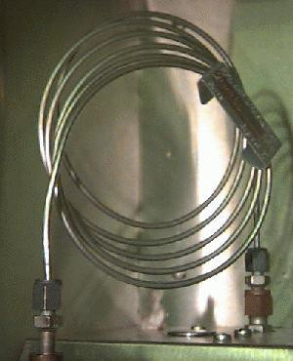

Slide 16
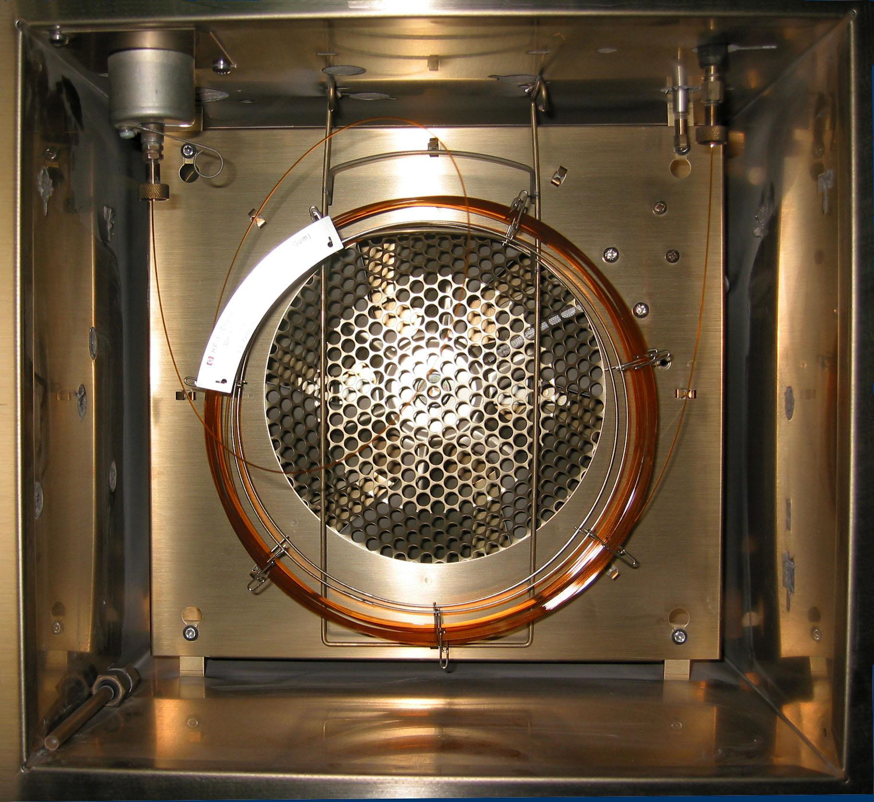
Column Ovens

Slide 17
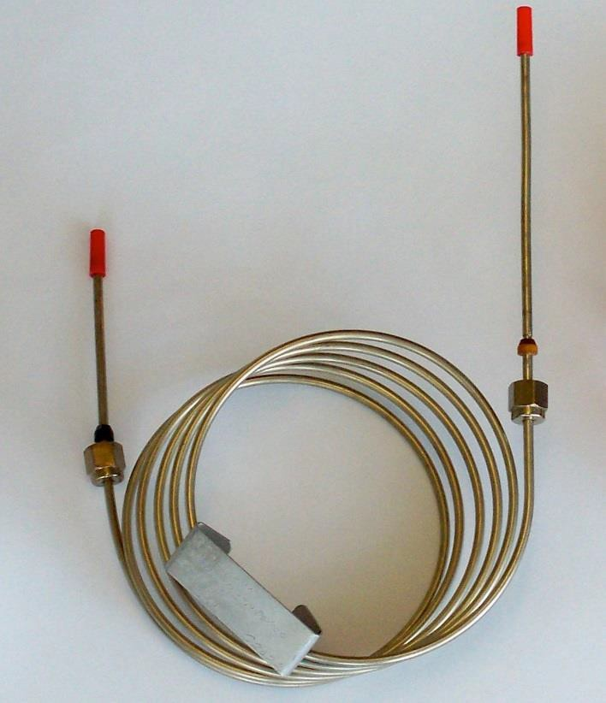
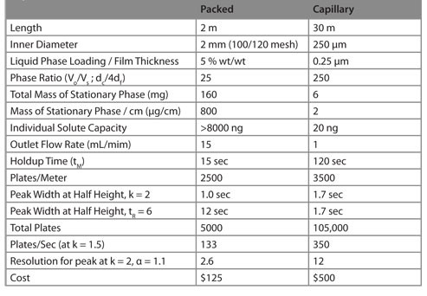
Packed Columns
Packed columns are fabricated from glass, metal (stainless steel, copper, aluminum), or Teflon tubes that typically have lengths of 2 to 3 m and inside diameters of 2 to 4 mm.

Slide 18
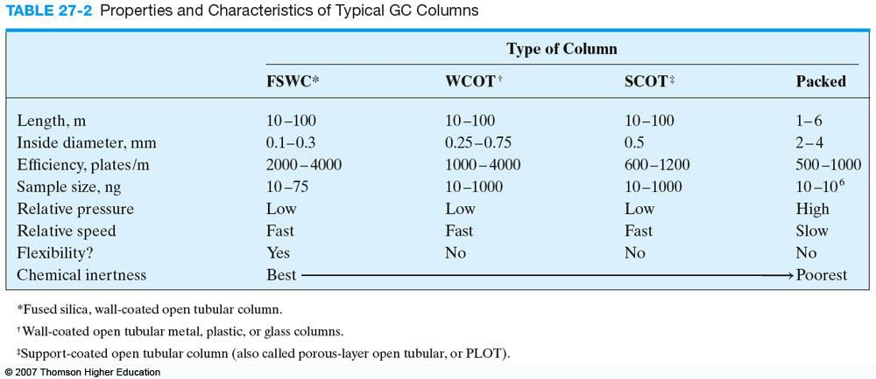

Slide 19
The Stationary Phase
Desirable properties for the immobilized liquid phase in a gas-liquid chromatographic column include: (1) low volatility (ideally, the boiling point of the liquid should be at 100ºC higher than the maximum operating temperature for the column); (2) thermal stability; (3) chemical inertness; (4) solvent characteristics such that k` and α values for the solutes to be resolved fall within a suitable range.

Slide 20
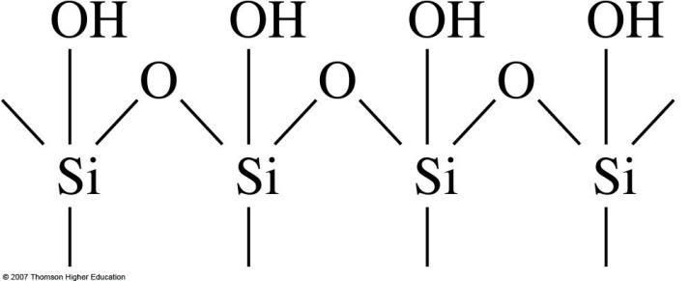
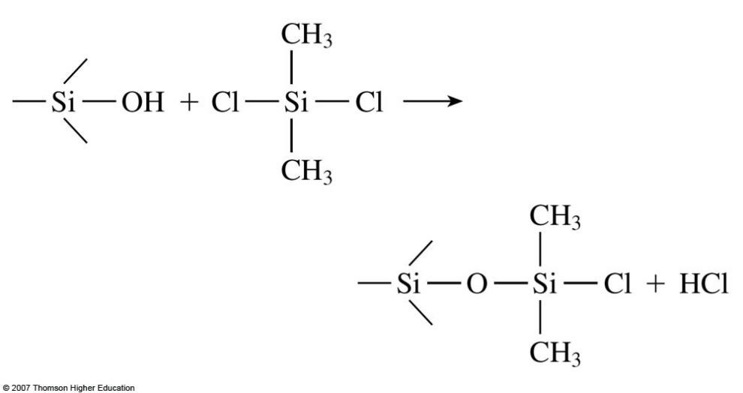
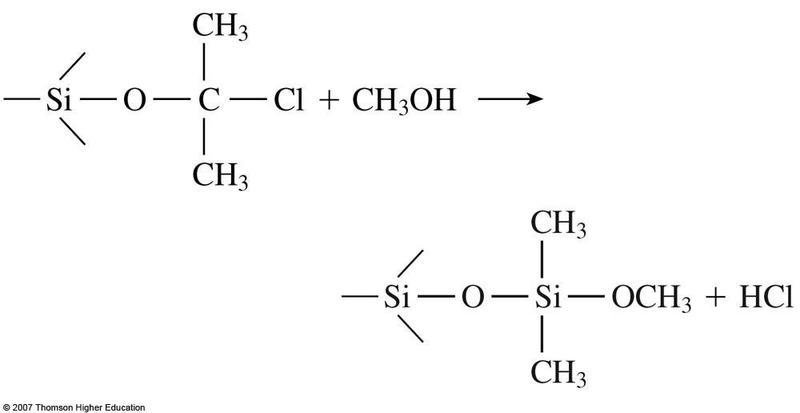
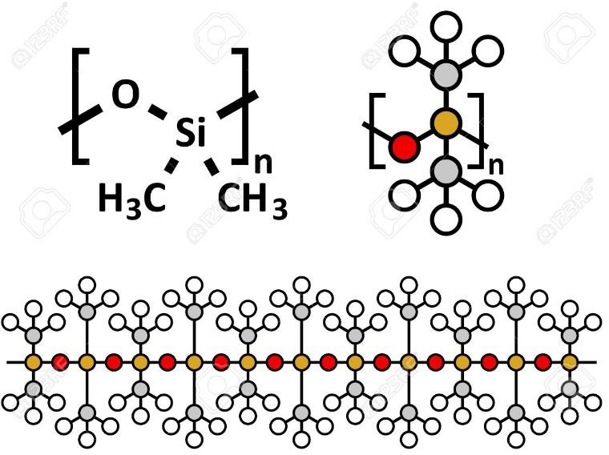

Slide 21
The Stationary Phase
Polar stationary phases contain functional groups such as Phenyl, –CN,--CO and –OH. Hydrocarbon-type stationary phase and dialkyl siloxanes are nonpolar, whereas polyester phases are highly polar. Polar solutes include alcohols, acids, and amines; solutes of medium polarity include ethers, ketones, and aldehydes.

Slide 22
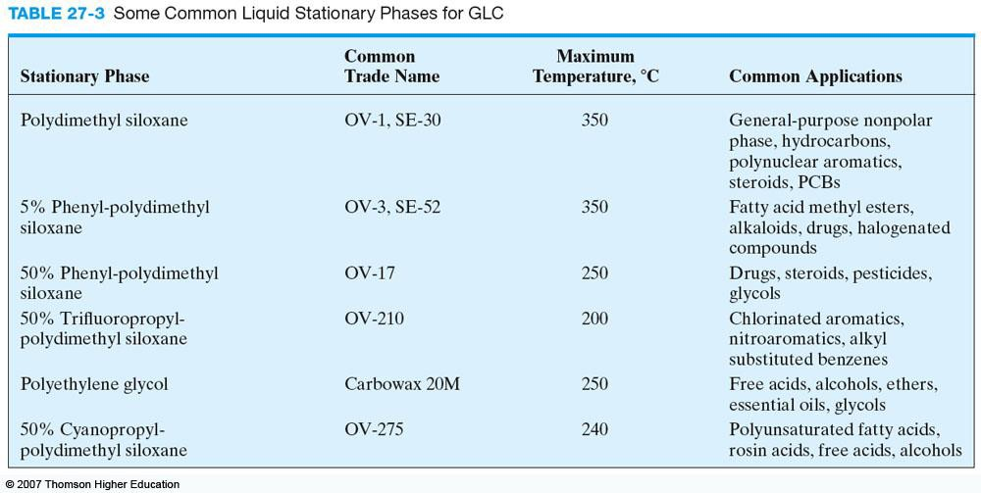

Slide 23
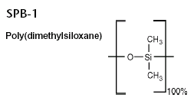
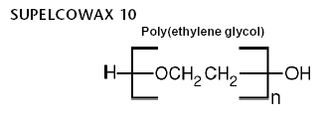
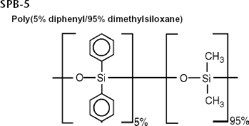
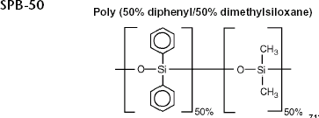
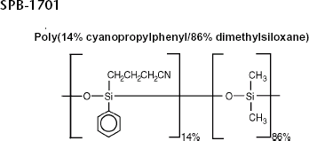
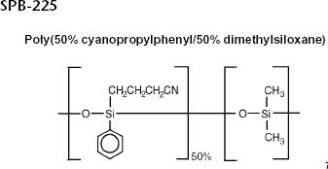
26

Slide 24
Detection Systems
Characteristics of the Ideal Detector:
Adequate sensitivity
Good stability and reproducibility.
A linear response
A temperature range from room temperature to at least
400ºC.
A short response time that is independent of flow rate.
High reliability and ease of use.
Similarity in response toward all solutes or a highly selective response toward one or more classes of solutes.
Nondestructive of sample.

Slide 26
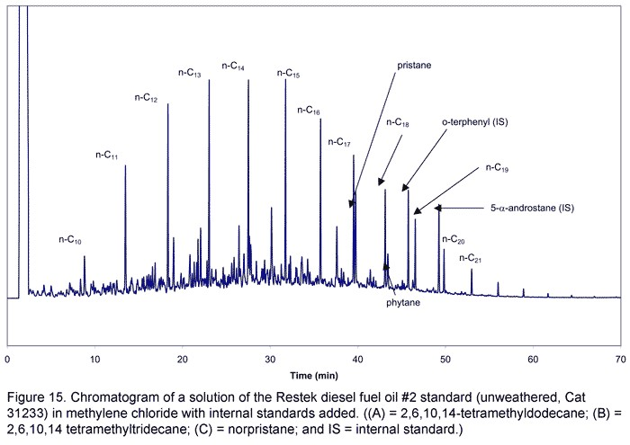
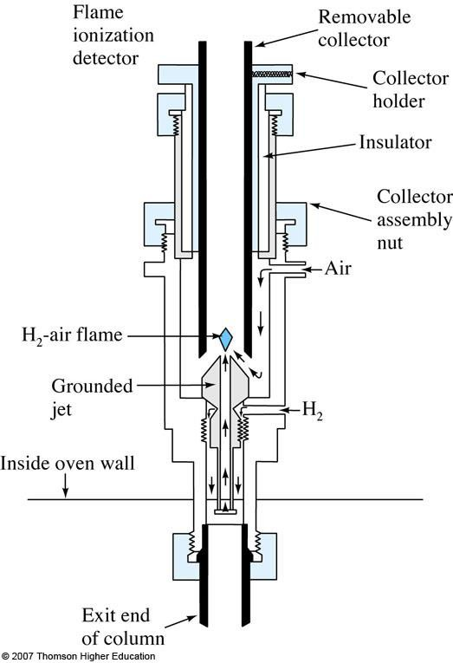
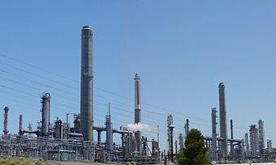
Flame Ionization Detectors (FID)

Slide 27
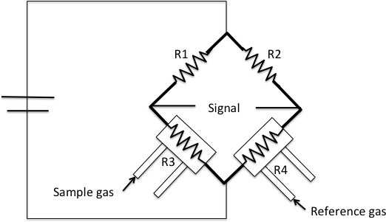
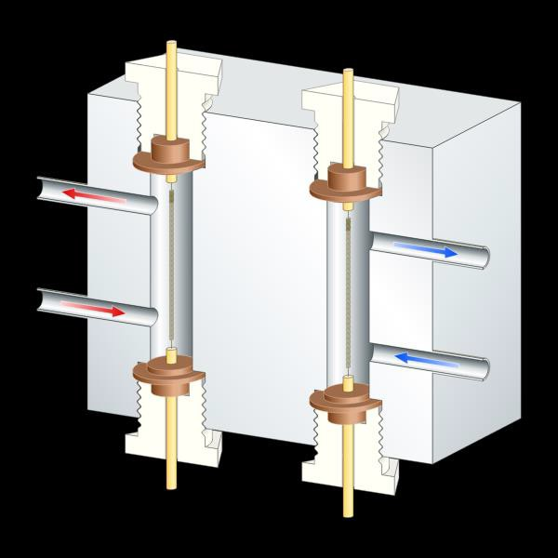
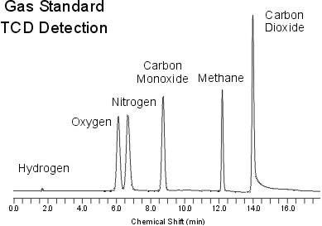
Thermal Conductivity Detectors(TCD)

Slide 28
Electron-Capture Detectors (ECD)
The effluent from the column is passed over a β emitter, usually nickel-63. An electron from the emitter causes ionization of the carrier gas and the production of a burst of electrons. In the absence of organic species, a constant standing current between a pair of electrodes results from this ionization process. The current decreases markedly, however, in the presence of those organic molecules that tend to capture electrons.
It is insensitive to functional groups such as amines, alcohols,
and hydrocarbons.
An important application of the electron-capture detector has been for the detection and determination of chlorinated insecticides.

Slide 29
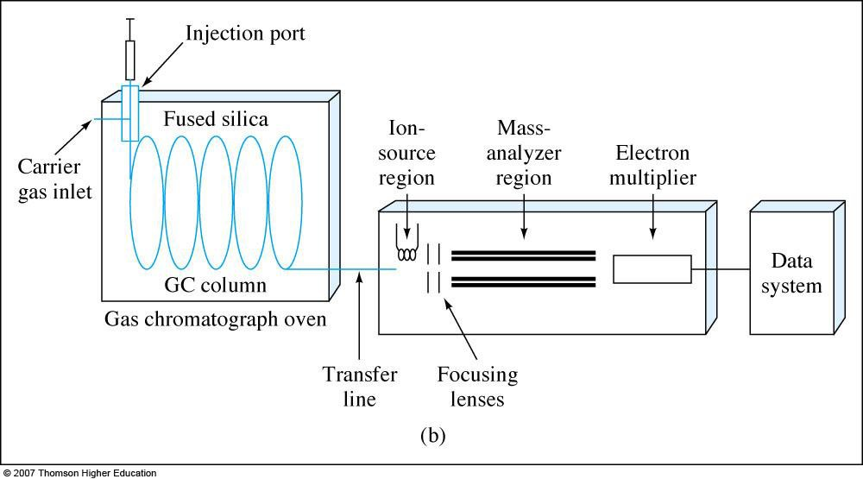
GC/MS

